Slide 1
K-12

Slide 2
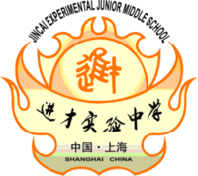
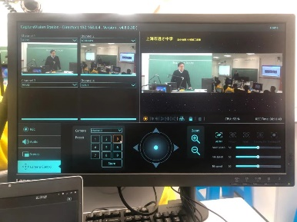
Jincai High School
China
Success Stories
Higher Education
Product: VC-A50P, VC-TR1, LC200, LC-RC01
Auto tracking, auto recording, Auto live streaming, and auto storage by one click of a mouse or bottom.
LC200 Media Processor supports on-line and off-line broadcasting, is a ideal platform which can satisfy the lecture recording demand.
When the teachers are teaching, they should be tracked automatically (including they walking into the student area).
Close-up mode is required
Multiple scenes layout available
“The solution is based on IP technology and support PoE. It means we can remotely control the cameras through LC200 and have the elasticity for equipment expand in the future without worries about circuit diagram issue. We also can record the electronic blackboard data while using for lecture. The teachers can easily operate both on-line and off-line lecture.”

Slide 3
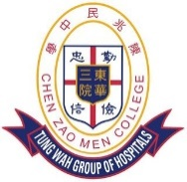
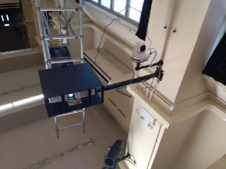
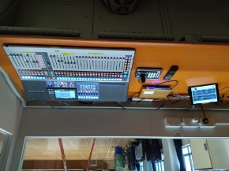
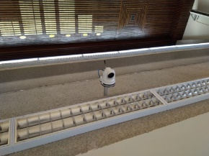
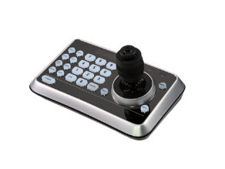
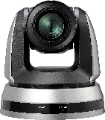
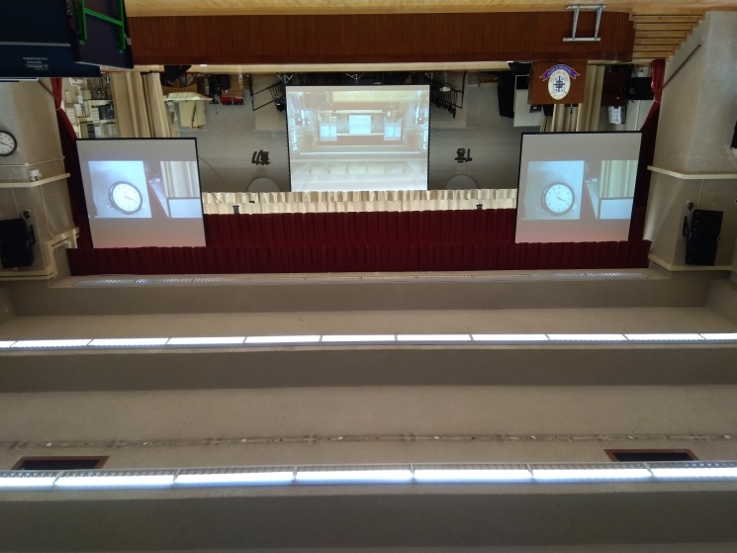
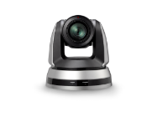
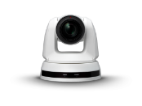
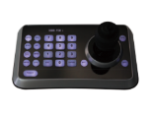
Tung Wah School
Hong Kong
Success Stories
K-12
Product: VC-A70H, VS-K20
Three PTZ cameras VC-A70H are installed in the school hall to capture live performance. Cameras are connected to a switcher, and the image is displayed by a projector.
Camera controller VS-K20 is used to control PTZ remotely.
Cat 5e (HDBaseT)
Cat 5e (HDBaseT)
Cat 5e (HDBaseT)
Lumens
PTZ Camera
VC-A70H
Video Switcher
RS232/ RS422 Daisy Chain
RS232/ RS422
HDMI
Lumens Camera Controller
VS-K20

Slide 4
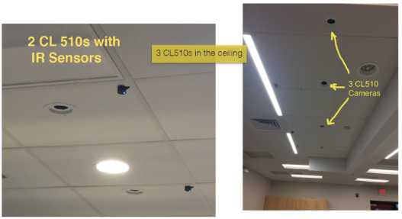
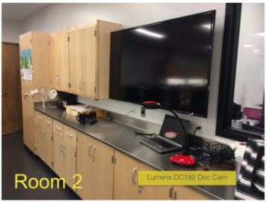
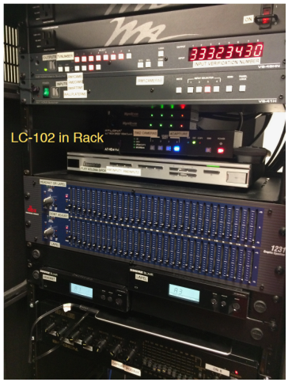
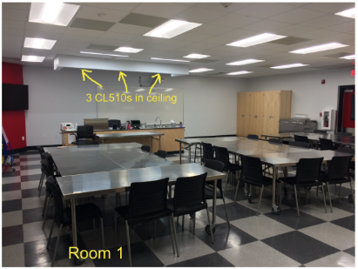
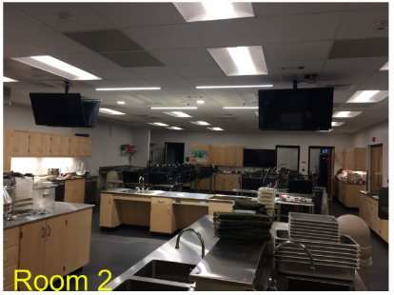
Culinary Lab in high school
USA
Success Stories
Higher Education
Product: CL510, DC192, VS-LC102
Two side by side classrooms, each classroom has three CL510 ceiling cameras above the cooking workstation to capture the overhead view of the stovetop, preparation are, and the sink.
VS-LC102 CaptureVision Station is used to record cooking demonstration and stream live to the neighboring class.
The document camera DC192 is connected to the flat panel to show objects in real-time.
“Using the installed Lumens products teachers can broadcast live from their classroom or transmit the CL510 video signal to the neighboring class. With the remote control, teachers can operate each CL510 camera with such features as pan, zoom, mask, and make other picture quality adjustments. Teachers can also record or stream live cooking demonstrations and lessons to the LC-102 CaptureVision Station as well as using the CL510 remote to capturesnapshots of each area during their live presentation.”

Slide 5
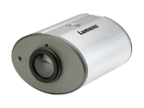
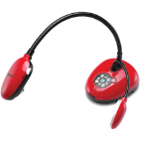
Culinary Lab in high school
USA
Success Stories
Higher Education
Product: CL510, DC192, VS-LC102
Lumens Ceiling Camera
CL510
Cat 5e
Cat 5e
Lan
Router
VGA to HDMI
VGA to HDMI
VGA to HDMI
Cat 5e
Unicast
Multi-cast
Streaming
HDMI
Lumens Media Processor
VS-LC102
HDMI
HDMI
HDMI
Display 1
Display 2
Display 3
Lumens Document Camera
DC192

